Slide 1

FEE project
Name – Anubhav Gupta Roll number – 2110990227 Group number – G5
Year – 3rd year(5th semester)
Course instructor – Lavish Arora sir

Slide 2
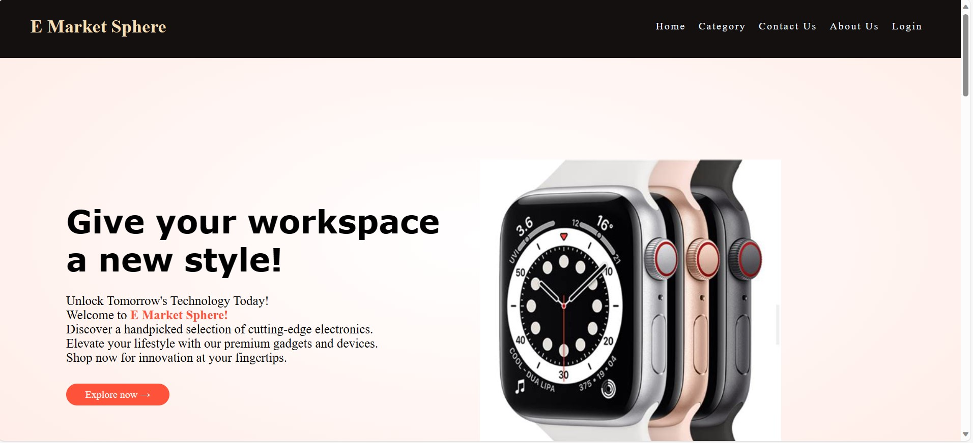
This is how my home page looks, as you can see the website name is “E Market Sphere”, the header allows us to explore other pages , we can also explore the category page through the “explore now!” Button.

Slide 3
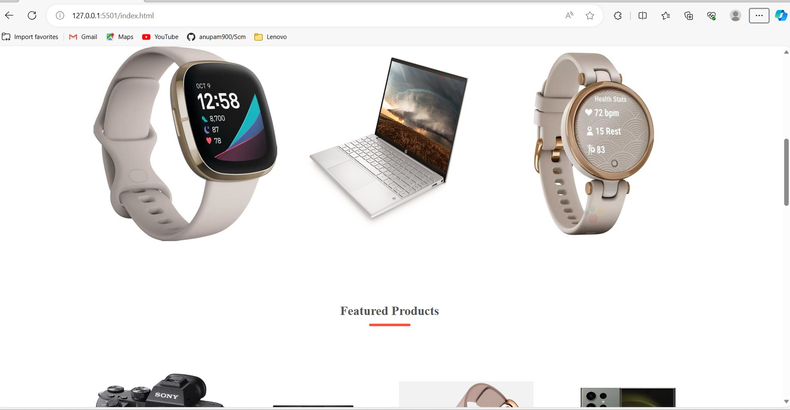
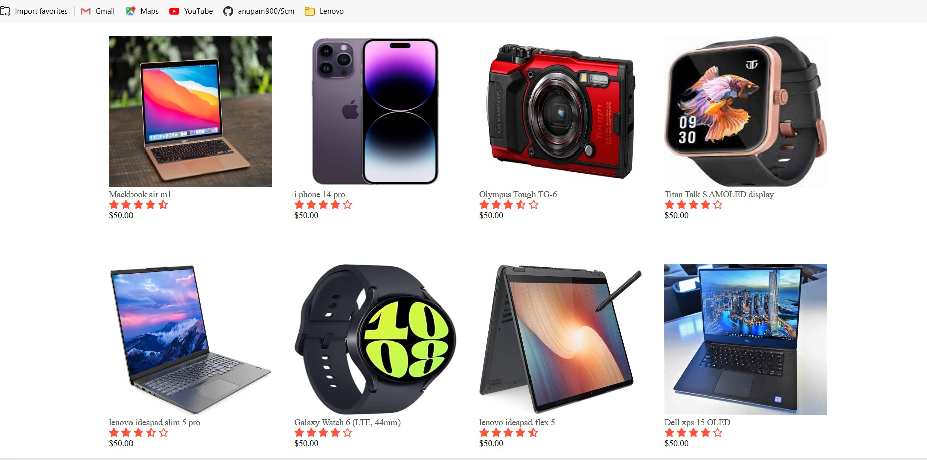
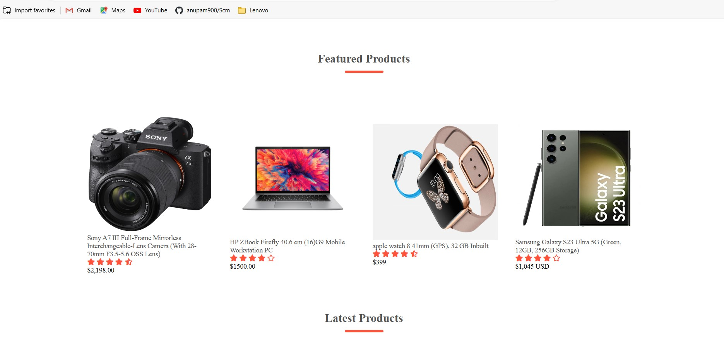
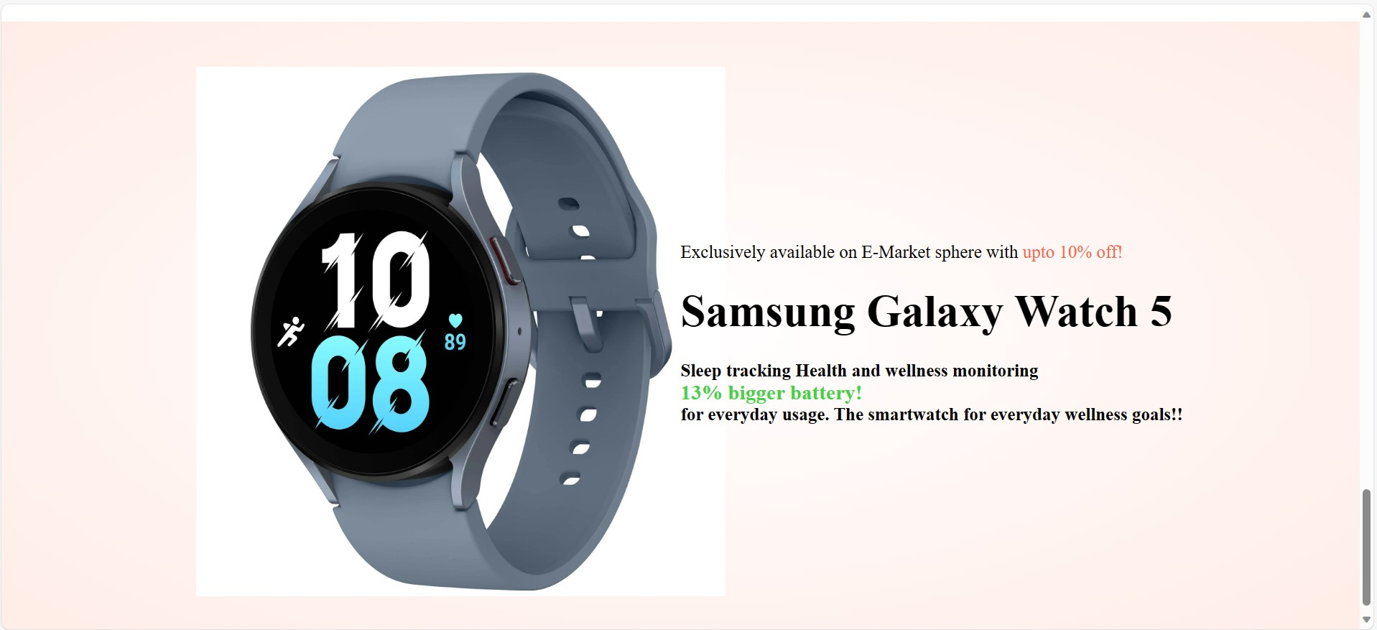
This is how the home page looks further on scrolling down

Slide 4
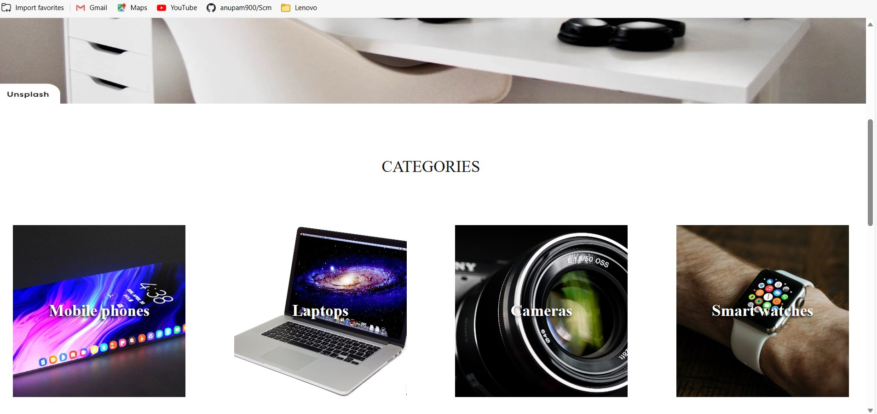
Here are the categories I have added in my category page(4 categories; mobiles, laptops, cameras & smartwatches), allowing users to explore a variety of products themselves.

Slide 5
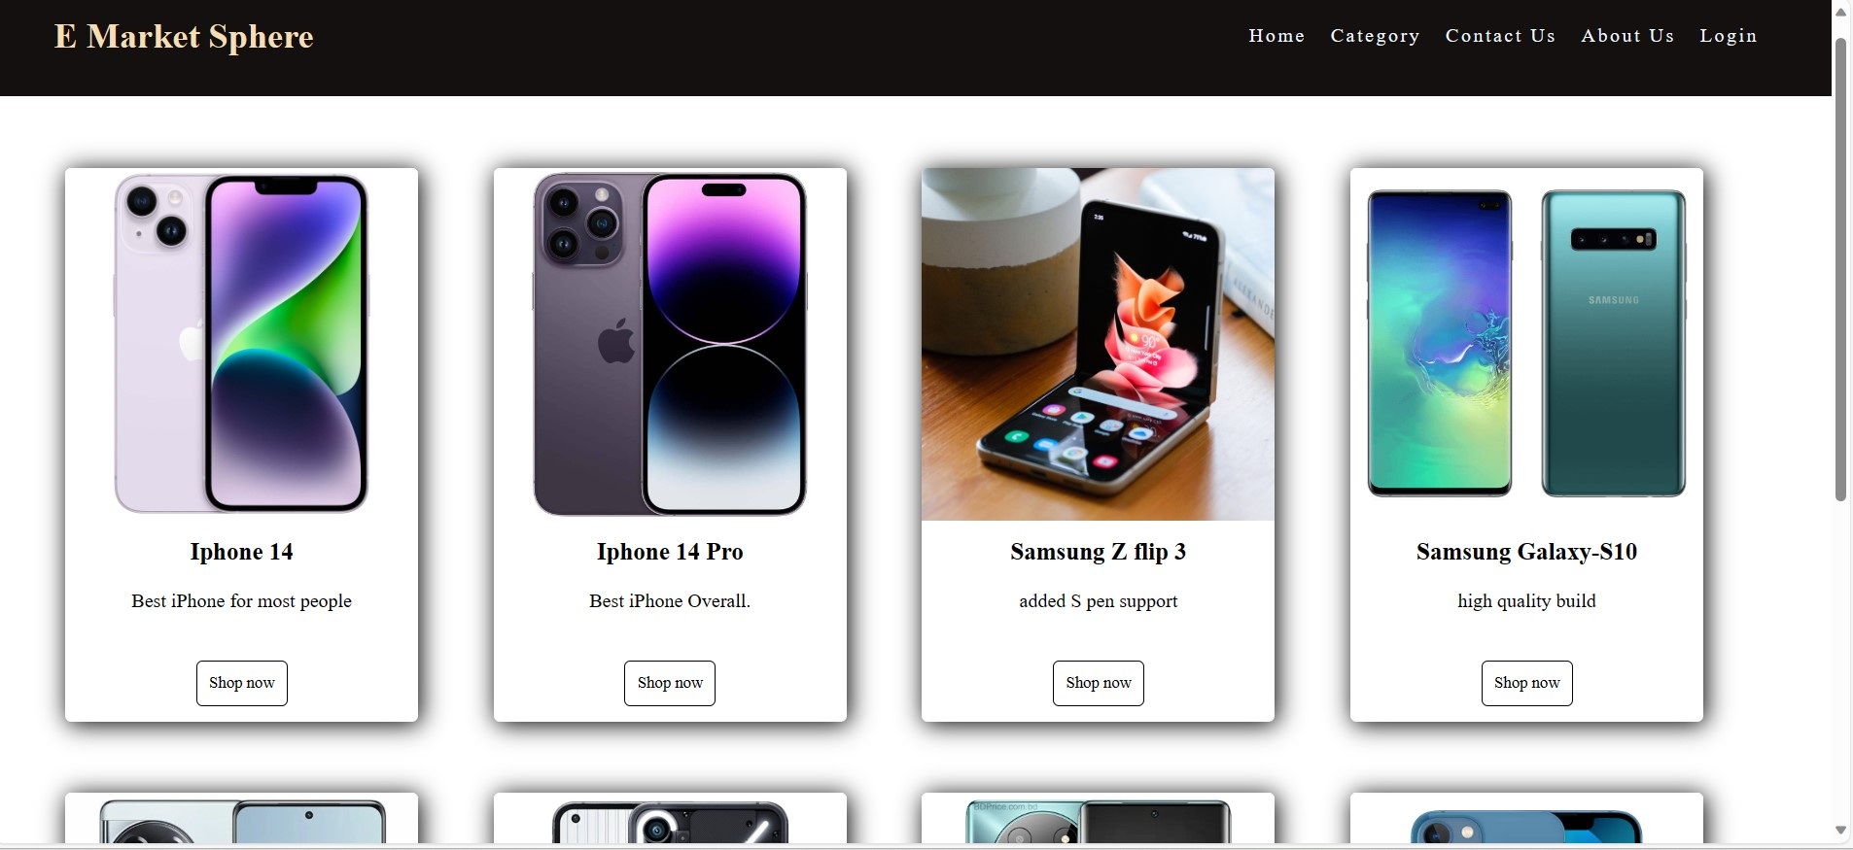
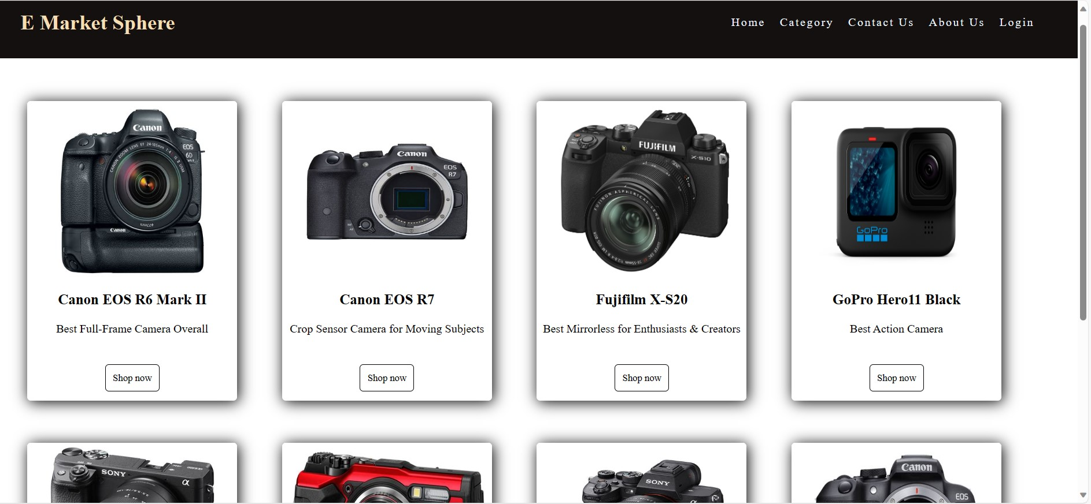
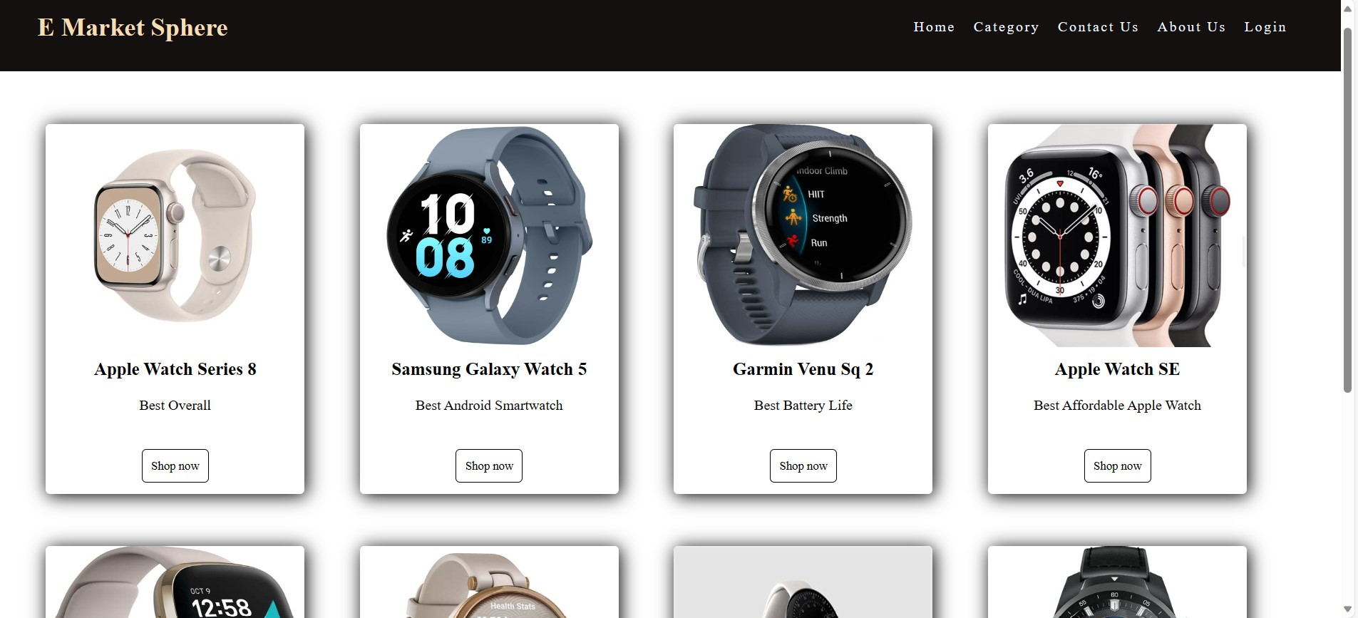
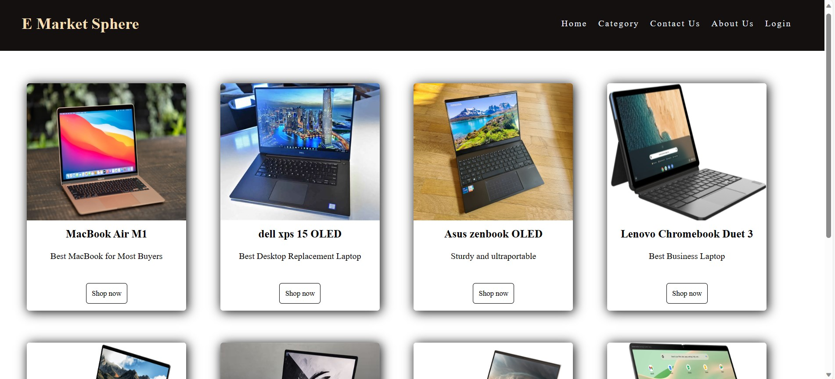
The sub-categories for the categories look like this
(3) Cameras
(1) Mobiles
(2) Laptops
(4) Smart watches

Slide 6
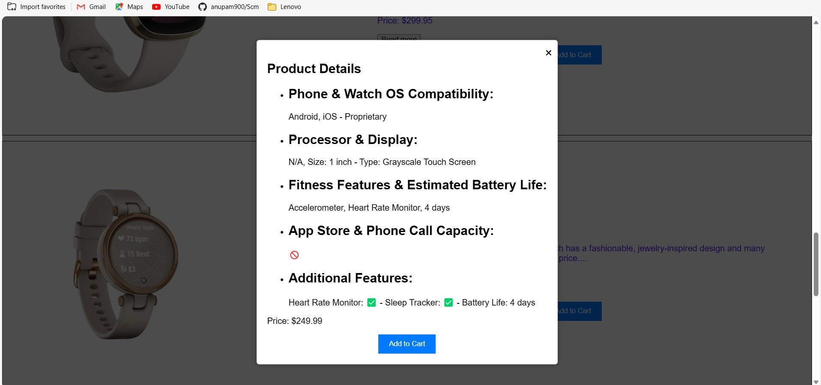
When the visitor clicks on “shop now” a modal window appears which shows the specifications(specs) of the specific product.

Slide 7
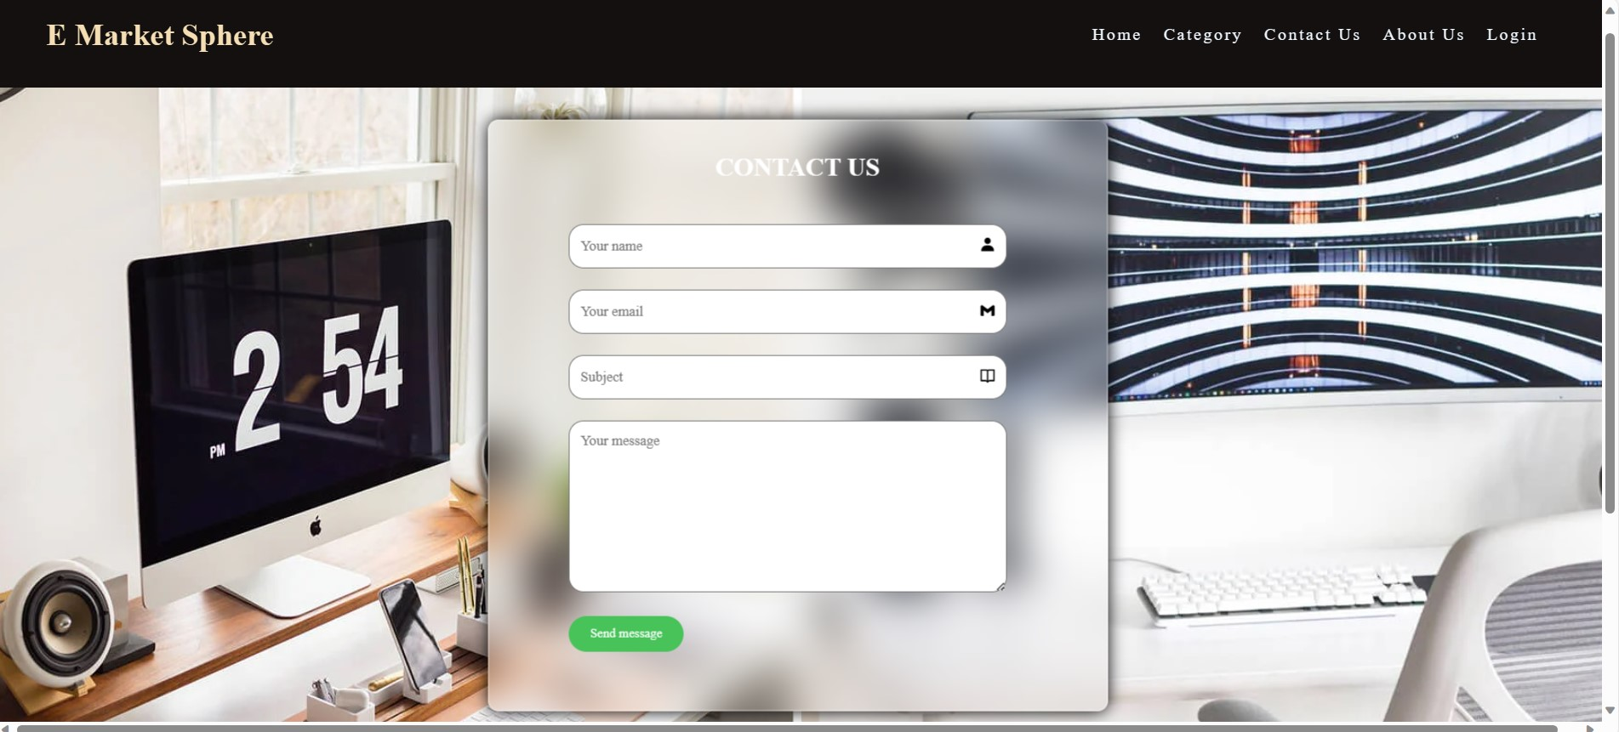
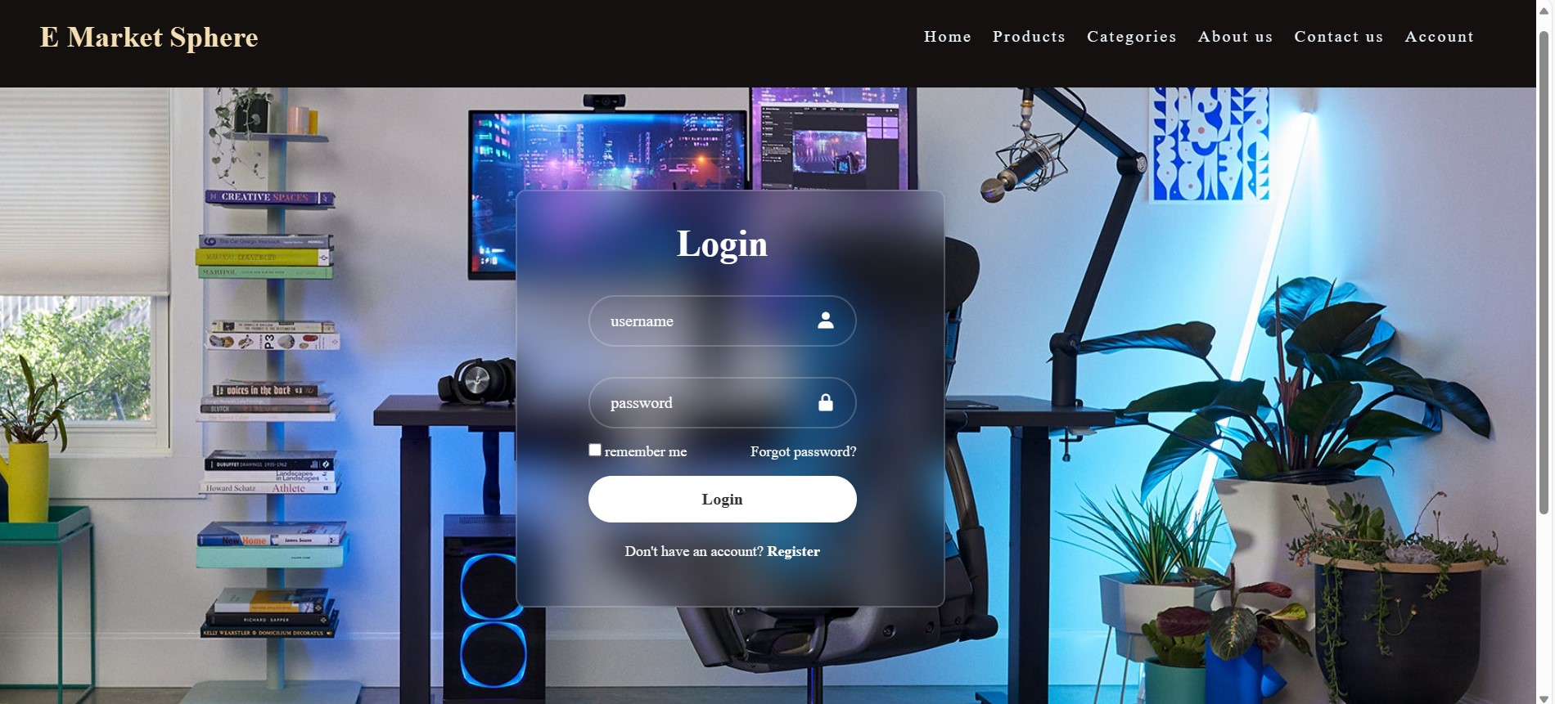
Here is the contact us page and the login page
1. Contact us page
2. Login page

Slide 8
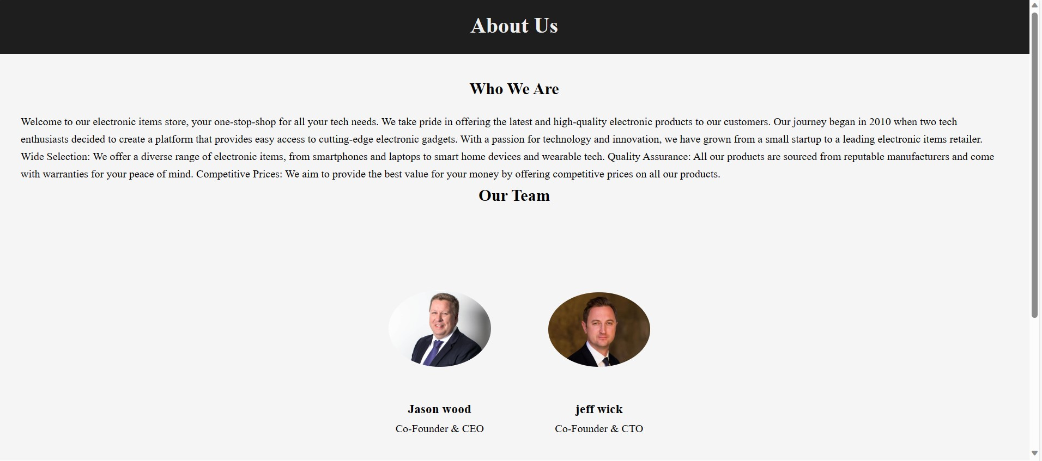

The “About us” page lets people know more about our website. our "About Us" page provides essential information, including the organization's identity, mission, and key team members. It establishes trust and credibility while conveying the brand's personality and achievements.

Slide 9
The motive to build this website was to get a strong hold on the concepts of html, css and javascript and learn how to manage different things at the same time. Also, we learned how to decouple the different aspects of the project , lavish sir helped us by teaching how to do such things while also getting better at learning the concepts of front-end engineering. This project helped me get better at javascript because it was real challenge as a beginner for me to implement an indeal javascript code in this project.
1.
2.
3.

